Slide 1
Competitive Grant Writing 101
What you can do
to increase your success!

Slide 2
Purpose of the Presentation
Share helpful hints for grant acquisition
Outline the process for proposing projects
Briefly describe the components of a proposal
Offer some ways to overcome common missteps
Provide some resources and technical assistance

Slide 3
Helpful Hints
Determine your purpose
Developing new programs or studies
Sustaining current programs
Resource acquisition or fundraising

Slide 4
Common Terms
TERM
DEFINITION
Funder/Grantor
Grant
Proposal
Request for Application, Request for Proposal, Funding Opportunity Announcement
Grantee
Who funds the grant
Award of a sum of money
Document prepared to receive funding or respond to a request
Announcement or solicitation document with detailed instructions for submitting a proposal
Organization receiving the grant

Slide 5
Connect with Funders
Identify funders who are aligned with your organizational goals; obvious and not so obvious resources
Corporations – trend focusing on corporate responsibility
Foundation Center Cooperating Collections
www.foundationcenter.org (library of funding resources)
Common grant application
www.givingforum.org
State departments (LGIF, ODJFS, OCJ, etc.)
Federal departments www.grants.gov (sign up for alerts)
Catalog of Federal Domestic Assistance (CFDA)
www.cfda.gov

Slide 6
Examples of non-government funders (may require lead applicant to be a non-profit agency)
UPS Foundation
United Way
Woodruff Foundation
Fairfield Foundation
PNC Trust
Robert Wood Johnson Foundation
Bill and Melinda Gates Foundation
Susan G. Komen Foundation
AVON Foundation
W.K. Kellogg Foundation
Henry J. Kaiser Family Foundation
Local/Corporate
National

Slide 7
Websites to review
www.grants.gov
www.fdncenter.org
www.npguides.org
www.guidestar.org
www.foundations.org

Slide 8
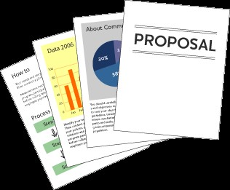
Types of Proposals
Program – offers specific services
Research – studies a topic or issue,
may be combined with services
Training – provides education
Planning – prepares for larger proposal or coordinates with a program
Technical assistance – helps other agencies
Capital improvement – funds construction or equipment purchases

Slide 9
Make a plan
Write down a flexible strategy for seeking grants
Immediate and long range goals should be considered
Keep it up to date
Review it and revise it based on ongoing SWOT
Involve all levels of the organization
Identify a lead or champion for the effort
Hold short meetings and give homework assignments
Build relationships and involve stakeholders (collaborations, letters of intent, letters of support)

Slide 10
Find the right funding partner(s) & pay attention to that partner’s expectations
The grant proposal needs to address the stated requirements or needs of the grantor
Read the request for proposal carefully and provide the details that the funder expects
A good idea is a good first step…
Research organizations already funded
Pay attention to the type of proposal requested

Slide 11
Prepare a well-written proposal
Collect relevant information for planning
Delegate tasks and allow for group effort
Develop a work plan, including a timeline (GANNT Chart) and checklist

Slide 12
Review the selection criteria
Is the process for selection outlined?
What are the deadlines?
Is there a page limit?
What agreements or letters of intent are required?
What forms are required?
Is there local legislation needed?

Slide 13
Tips in the Planning Stages
1
Read all of the application materials
2
Take notes
3
Ask questions
4
Pay attention to eligibility requirements
5
Develop a timeline, work back from the due date

Slide 14
Writing Stages
Re-read the announcement
Join in on any calls for interested applicants
Review previous submissions and responses to those submissions
Follow instructions
Begin gathering letters of intent and support – early in the process!
Gather basic information, descriptive statistics

Slide 15
Keep electronic copies of organizational charts, history, and past proposals in a shared drive
Assign tasks and responsibilities to team members

Slide 16
Components of a Proposal
Cover letter/Abstract
Statement of need
Project description/Methods
Evaluation plan
Budget and budget justification
Appendices

Slide 17
Cover Letter Abstract
Who you are
Scope of the project
Major tasks
Costs
Letterhead

Slide 18
Statement of need
Do your research
Include local data that recommends the type of program, use comparative statistics
Convey the uniqueness of the proposal; address community needs
Make a local case for the program

Slide 19
Statement of Need
Describes the nature of the problem or need with supportive evidence
Discusses the factors that contribute to the problem
Identifies gaps in services
Provides rationale for the project – why it is relevant

Slide 20
Major tasks
Defined goals and objectives, attainable within the grant period
Specific, Measurable, Achievable, Realistic, and Time-phased objectives

Slide 21
Project Goals and Objectives
OBJECTIVES
Respond to needs and give the ultimate mission or purpose of the program
Represent the immediate measured outcomes that are essential for achieving the ultimate goals

Slide 22
Drafting program objectives
Can the objective be realized during the life of the program?
Are there enough resources to support the objective?
Are the objectives consistent with policy and procedures?
Do the objectives align with
the community culture?

Slide 23
Drafting the project description
Relate goals to that of the funder
State the goals as a result of the proposed program
SMART objectives
Plan for evaluation outcomes in your objectives – define how you will measure each objective

Slide 24
Be creative
Do not rely solely on previous program materials
Propose a new idea or method

Slide 25
Logic Model
A logic model is a top-level depiction the flow of materials and processes to produce the results desired by the organization or program.
The model can be very useful to organize planning and analysis when designing outcomes-based evaluations of programs.

Slide 26
Logic Model
Logic models typically depict the inputs, processes, outputs and outcomes associated with an organization and its programs
Just be consistent with the terms
Involve stakeholders!
Include assumptions
and constraints

Slide 27
Inputs
PEOPLE
MONEY
EQUIPMENT
SUPPLIES
IDEAS
TIME
These are materials that the organization or program takes in and then processes to produce the results desired by the organization.

Slide 28
Processes
Processes (Activities, Strategies, Methods)
Processes are used by the organization or program to manipulate and arrange items to produce the results desired by the organization or program.
Major recurring processes associated with producing the results desired by the organization or program
For example, the major processes used by a program that provides training to clients might include recruitment of learners, pretesting of learners, training, post-testing and certification

Slide 29
Outputs
Outputs are usually the tangible results of the major processes in the organization.
They are usually accounted for by their number, for example, the number of students who failed or passed a test, courses taught, tests taken, teachers used, etc.
Outputs are frequently misunderstood to indicate success of an organization or program.

Slide 30
Outcomes
Outcomes are the (hopefully positive) impacts on those people whom the organization wanted to benefit with its programs.
Outcomes are usually specified in terms of:
a) learning, including enhancements to knowledge, understanding/perceptions/attitudes, and behaviors
b) skills (behaviors to accomplish results, or capabilities)
c) conditions (increased security, stability, etc.)
It's often to specify outcomes in terms of short-term, intermediate and long-term.

Slide 31
Logic Model (and evaluation) Templates
https://www.childwelfare.gov/management/effectiveness/models.cfm
http://www.uwex.edu/ces/pdande/evaluation/evallogicmodelworksheets.html
http://www.cdc.gov/eval/resources/index.htm
http://www.ojjdp.gov/grantees/pm/logic_models.html
http://www.innonet.org/client_docs/File/logic_model_workbook.pdf

Slide 32
METHODS
METHODS
This is the project design, what you plan to do
Define who will be responsible for each activity
Give a timeline
Provide a rationale, or why it best to be done in the way you propose
Theory or scientific rationale
What is new or innovative

Slide 33
Suggested activities for methods
Preparation
Hiring
Collaborations
Development of materials
Program (training, services, etc.)
Evaluation

Slide 34
Methods
Provide a rationale for methods (literature review, best practices, evidence)
Make sure methods make sense with the budget (incentives, travel costs)
Consider in-kind contributions, include those in the budget
Outline all tasks with timeframe, responsible staff and how objectives will be measured - Explain how you will carry out and measure each objective (GANNT Chart)
Relate methods to goals and objectives (and to the need)
Relate goals and objectives to the announcement

Slide 35
Evaluation
Use visuals to map evaluation to objectives or activity
Make sure the proposed evaluation will demonstrate that the program accomplished the stated goals and objectives
Comprehensive evaluation
Process
Outcome

Slide 36
Process Evaluation
Process evaluation can spot problems or issues early in the project
Assess staff, budget review, how well the program is doing overall
Measure participation, implementation, satisfaction, exposure, barriers, etc.
Establish databases, registration sheets, surveys, interviews

Slide 37
Process Evaluation Questions
Who were the participants?
How were the participants recruited?
How many sessions were conducted?
To what extent was the program implemented as designed?
How many materials were distributed?
How satisfied were clients?
EXAMPLES

Slide 38
Outcome Evaluation
Define short term, intermediate, or long term goals
Determine if goals and objectives were met
Justify the need for additional funding
Ensure effective programs continue

Slide 39
Examples of Outcome Evaluation Questions
Did the program activities lead to desired change?
What changes occurred as a result of the program?
Did the program increase positive behaviors?

Slide 40
Evaluation Plan
State expected outcomes
Determine the type of evidence needed
Develop a data collection plan
Describe data analysis and reporting procedures

Slide 41
Budget
Outline budget items carefully and use standard amounts for expenses
Funder will compare the cost of the program to its benefit
The budget needs to be reasonable for the work proposed
Include a budget justification

Slide 42
Budget justification
Clearly explains the budgeted item
Presents all required items
Use the categories that are included in the announcement
Research range of costs, use averages
Cross walk between key activities and items in the budget to be sure there is a match between activities and budget
Do not exceed amount of available funding

Slide 43
Steps in budgeting
Establish budget period
Estimate expenses based on methods
Determine if indirect costs are allowed (sometimes they are not permitted)
Estimate match money
Justify each item

Slide 44
Direct Costs
Direct expenditures of program funds
Personnel salaries
Benefits
Supplies
Equipment
Consultant fees
Travel
Printing costs
Operating costs

Slide 45
Indirect Costs
Equipment &
Facilities
Building
maintenance
Administrative
overhead
Utility
costs
Indirect costs facilitate the maintenance of the program operations; the rate is often found in the announcement.

Slide 46
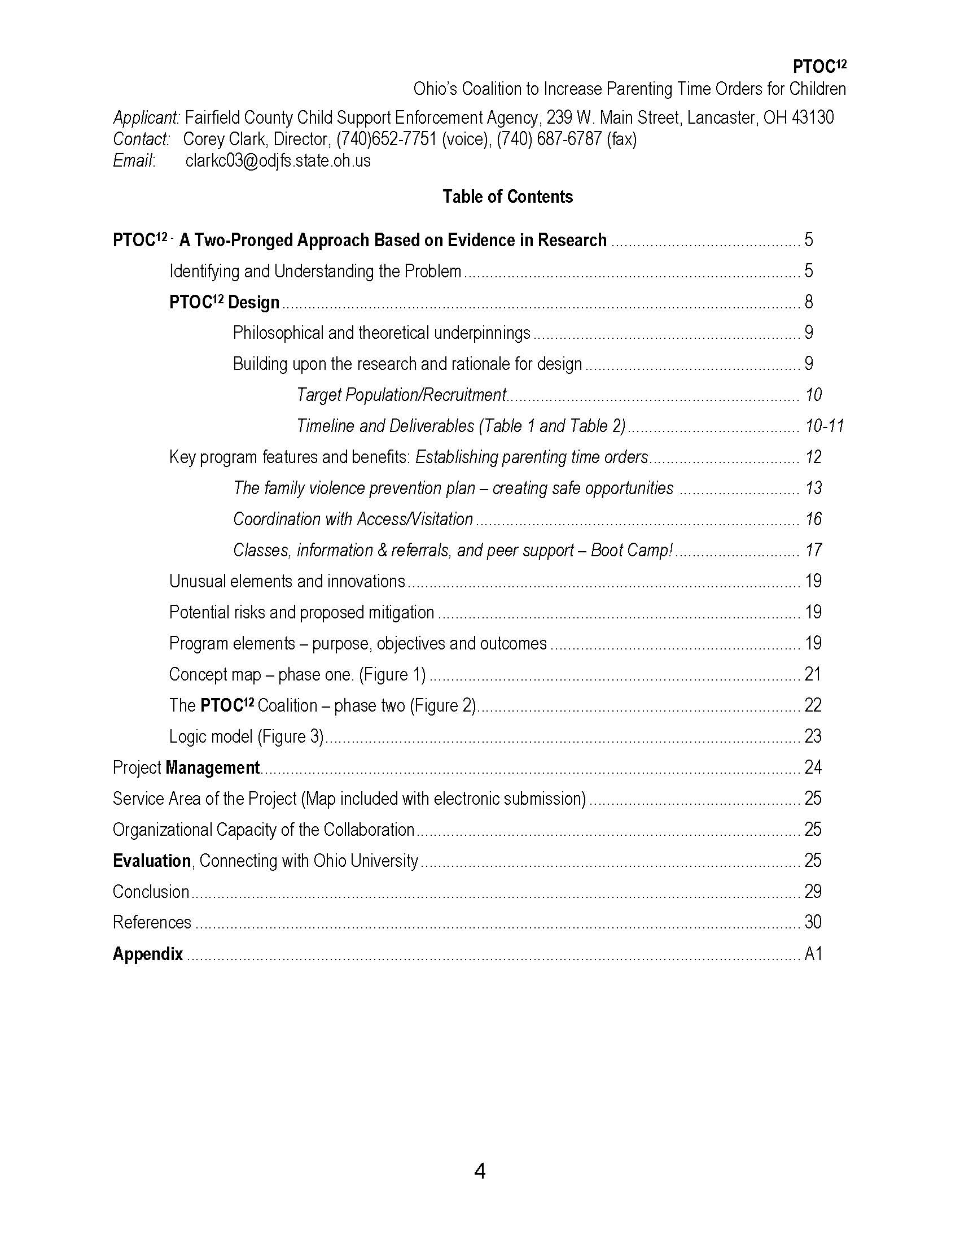
Appendices
Read the announcement to see what is permitted
Check limits on page limits
Common errors
Too long
Formatting is not allowed
Appendices are not permitted

Slide 47
Appendices
Additional material to support the grant proposal
Agency-related information
Project-related information
Survey instrument
Diagrams
Charts
Letters of support
Resumes

Slide 48
Submission
Check copying and mailing
Most are electronic submissions
Check for signature requirements
Review all electronic instructions well in advance

Slide 49
Scoring and getting feedback
Systematic review process
Examine application for criteria and self-score
Acceptance is great!
Rejection can be a good learning opportunity
You may have to request a summary of the scoring and comments

Slide 50
Review your work before submitting
Completeness
Clarity
Calculations
Make sure the flow is logical
Include a table of contents
Use correct grammar and correct terms

Slide 51
Common mis-steps
Inappropriate formatting
Lack of direction or lack of details
The need is not established
No local data included
No clear objectives
The methods are not clearly outlined
Lack of innovation – copy of previous program
Budget exceeds limits or lacks details/justification
There is a mismatch of the budget and activities
The evaluation lacks details or does not match objectives

Slide 52
Governmental Agency Review
Primary and secondary reviewers discuss assessment
Provide written comments
Members of the committee vote

Slide 53
Sample criteria
Significance – is the problem relevant and important?
Approach – Are the conceptual framework, design, methods and analyses appropriate?
Innovation – Is the project creative or original?
Organization – Is the organization trained to carry out the work?
Environment – Is the environment ripe for success?

Slide 54
Good Luck
Reach out to others
Bring in a team to help with the drafting
Plan ahead
Double check your work
Keep previous submissions and standard, descriptive statistics and paragraphs in a shared file

Slide 55
Examples / Resources / E-clips / Blogs / Videos
http://grants.nih.gov/grants/writing_application.htm
http://www.niaid.nih.gov/researchfunding/grant/Pages/aag.aspx
http://governmentgrant.com/writing-grants
www.ManagementConcepts.com
http://blogs.ManagementConcepts.com/grants
http://www.youtube.com/watch?v=sA67g6zaKOE
http://www.ganttproject.biz/

Slide 56
Questions
?
Carri Brown, CGFM, MBA
County Executive Director
brownc12@odjfs.state.oh.us

