Slide 1
FAIRFIELD COUNTY
Leadership Conference – Looking To 2013 –
November 2012 Roundtable

Slide 2
TOGETHER, FAIRFIELD COUNTY LEADERS SHOULD BEGIN WORK ON:
Addressing the county’s need for grant writing/ grant acquisition & administrative skills
Name a county grant writer/county administrator
Establish a grant writer
Collect and save grant records; conduct research
Conduct a grant writing workshop

Slide 3
Addressing ways to store records electronically, while being “green”, saving long term costs
Identify ways to go paperless
Address historical archiving of records
Identify ways to go green

Slide 4
Addressing ways to increase communication & organizational knowledge
Create a job shadow program
Travel among departments to learn more about how all departments work
Develop a county liaison to work in and with multiple offices

Slide 5
Addressing ways to increase communication and organizational knowledge
Increase ways to communicate among departments
Improve interdepartmental communication
Document and communicate introductions of new employees/create a county informational source about people of the county and how to contact employees

Slide 6
Planning a broadband initiative

Slide 7
Reviewing the efficiencies of all workflows and processes

Slide 8
Updating fleet management plans and creating collective fleet management practices, sharing maintenance if possible

Slide 9
Updating building and facility plans
Update and review building/facility plans
Look at building options across the board, re-visit the facilities plan

Slide 10
Increasing hours of operation and sharing employees
Reviewing all county office hours of operations, extending those that close down during lunch or during the day by sharing employees, reviewing options to extend operational hours if there is a demand
Increasing options to share employees

Slide 11
Increasing education and outreach efforts, providing more information to the public
Increase awareness of services
Increasing outreach efforts to the public
and to all stakeholders
Address zoning questions
Conduct outreach efforts beyond Lancaster, seek to reach all parts of the county, work on outreach to all audiences

Slide 12
Developing a social media strategy/identifying a team that can help everyone use social media
Use social media to create tourism materials, create You Tube videos with David Fey promoting the historical parks
Develop a county wide social media policy
Determine what is required to use desired social media tools, such as equipment, servers, and content managers

Slide 13
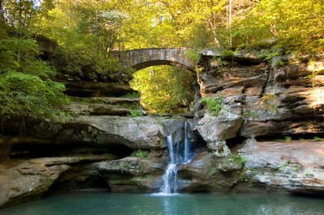
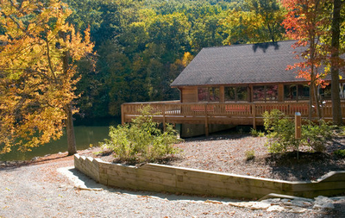
Promoting tourism in unified ways across all departments
Use social media and other tools for tourism
Develop a comprehensive plan for increasing tourism
Connect all departments into common theme for economic development & tourism

Slide 14
Offering options and programs to employees to improve safety and productivity
Fund workplace safety initiatives
Offer continuing education for employees
Establish more flexible options and ways for employees to work at home using technology, saving long term costs
Create a county-wide wellness committee for employees
Create a committee that would plan special events for employees and focus on overall employee morale

Slide 15
Offer financial education for employees, relating to their options as county employees and to their financial health in general
Examine options for a health clinic for employees or for a doctor dedicated to county employees and their families, with the aim of reducing costs
Review insurance options, perhaps additional self-insurance options, with the aim of reducing costs
Conduct a county wide salary study or compensation plan, recognizing the close proximity to Columbus and competition in that market

Slide 16
TOGETHER, FAIRFIELD COUNTY LEADERS SHOULD CONTINUE TO WORK ON:

Slide 17
The Local Government Innovation Fund (LGIF) grant project, AIMS, applying for a loan through LGIF
Improving document imaging and management
Increasing technology/investing in technology

Slide 18
Communicating with the Board of Commissioners in a variety of ways
Holding roundtable discussions
Holding Leadership Conferences, work group meetings, retreats, etc.
Collaborative meetings and work groups

Slide 19
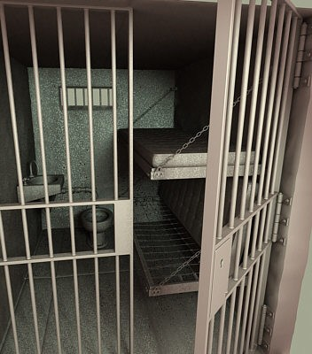
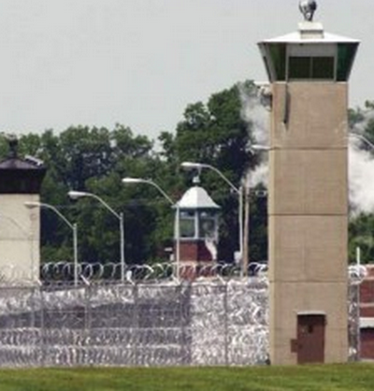
Considering alternatives for a jail
Addressing drug abuse
Considering all options to house prisoners
Notes:
Animated picture collection: left picture moves to front center
(Intermediate)
Tip: For the effects on this slide, it is recommended to use pictures with a “portrait” (vertical) orientation. This slide is the first slide in the picture collection sequence.
To reproduce the picture effects on this slide, do the following:
On the Home tab, in the Slides group, click Layout, and then click Blank.
On the Insert tab, in the Images group, click Picture. In the Insert Picture dialog box, select a picture, and then click Insert.
Select the picture. Under Picture Tools, on the Format tab, in the Size group, click the Size and Position dialog box launcher. In the Format Picture dialog box, resize or crop the image so that the height is set to 3.5” and the width is set to 2.35”.
To crop the picture, click Crop in the left pane, and in the Crop pane, under Crop position, enter values into the Height, Width, Left, and Top boxes.
To resize the picture, click Size in the left pane, and in the right pane, under Size and rotate, enter values into the Height and Width boxes.
Also in the Format Picture dialog box, click Line Color in the left pane. In the Line Color pane, select Solid line, click the button next to Color, and then under Theme Colors click Black, Text 1, Lighter 25% (fourth row, second option from the left).
Also in the Format Picture dialog box, click Line Style in the left pane, and then in the Line Style pane, in the Width box, enter 8 pt.
Also in the Format Picture dialog box, click Shadow in the left pane. In the Shadow pane, click the button next to Presets, and then under Perspective, click Perspective Diagonal Upper Right (first row, second option from the left).
Also in the Format Picture dialog box, click 3-D Format in the left pane, and then do the following in the 3-D Format tab:
Under Bevel, click the button next to Top, and then under Bevel click Relaxed Inset (first row, second option from the left). Next to Top, in the Width box, enter 8 pt, and in the Height box, enter 6 pt.
Under Depth, click the button next to Color, and then under Theme Colors click Black, Text 1, Lighter 25% (fourth row, second option from the left). In the Depth box, enter 12 pt.
Under Surface, click the button next to Material, and then under Standard click Warm Matte (second option from the left).
On the Home tab, in the Drawing group, click Arrange, point to Align, and then do the following:
Click Align to Slide.
Click Align Center.
On the Home tab, in the Clipboard group, click the arrow to the right of Copy, and then click Duplicate. Drag the duplicate picture to the right on the slide.
Right-click the duplicate picture, and click Change Picture. In the Insert Picture dialog box, select a picture and click Insert.
Select the first picture. On the Home tab, in the Clipboard group, click the arrow to the right of Copy, and then click Duplicate. Drag the duplicate picture to the left on the slide.
Right-click the duplicate picture, and click Change Picture. In the Insert Picture dialog box, select a picture and click Insert.
Select the picture on the left side of the slide. On the Home tab, in the bottom right corner of the Drawing group, click the Format Picture dialog box launcher. In the Format Picture dialog box, click 3-D Rotation in the left pane. In the 3-D Rotation pane, click the button next to Presets, and then under Perspective, click Perspective Heroic Extreme Right (third row, third option from the left).
Also in the Format Picture dialog box, resize or crop the image so that the height is set to 3.8” and the width is set to 2.53”.
To crop the picture, click Crop in the left pane, and in the Crop pane, under Crop position, enter values into the Height, Width, Left, and Top boxes.
To resize the picture, click Size in the left pane, and in the right pane, under Size and rotate, enter values into the Height and Width boxes.
Select the picture on the right side of the slide. On the Home tab, in the bottom right corner of the Drawing group, click the Format Picture dialog box launcher. In the Format Picture dialog box, click 3-D Rotation in the left pane. In the 3-D Rotation pane, click the button next to Presets, and then under Perspective, click Perspective Heroic Extreme Left (third row, second option from the left).
Also in the Format Picture dialog box, resize or crop the image so that the height is set to 4.17” and the width is set to 2.78”.
To crop the picture, click Crop in the left pane, and in the Crop pane, under Crop position, enter values into the Height, Width, Left, and Top boxes.
To resize the picture, click Size in the left pane, and in the right pane, under Size and rotate, enter values into the Height and Width boxes.
Select the picture on the left side of the slide. On the Home tab, in the Clipboard group, click the arrow to the right of Copy, and then click Duplicate.
Select the duplicate picture. On the Home tab, Drawing group, click Arrange, under Position Objects, point to Align, and then do the following:
Click Align to Slide.
Click Align Center.
Click Align Middle.
Under Picture Tools, on the Format tab, in the bottom right corner of the Size group, click the Size and Position dialog box launcher. In the Format Picture dialog box, on the Size tab, do the following:
Under Scale, clear the Lock aspect ratio check box.
Under Size and rotate, in the Height box, enter 5.83”.
Under Size and rotate, in the Width box, enter 3.89”.
Under Picture Tools, on the Format tab, in the Picture Styles group, click Picture Effects, point to 3-D Rotation, and then click No Rotation.
To reproduce the animation effects on this slide, do the following:
Right-click the slide background, and then click Grid and Guides. In the Grid and Guides dialog box, under Guide settings, select Display drawing guides on screen. (Note: One horizontal and one vertical guide will display on the slide at 0.00.)
On the Animations tab, in the Advanced Animation group, click Add Animation, and then under Emphasis click Grow/Shrink.
Also on the Animations tab, in the Animation group, click the Effect Options dialog box launcher. In the Grow/Shrink dialog box, do the following:
On the Effect tab, in the Size list, in the Custom box, enter 133%, and then press ENTER.
On the Timing tab, in the Start list, select With Previous.
Also on the Timing tab, in the Duration list, select 1.00 seconds (Fast).
On the Animations tab, in the Advanced Animation group, click Add Animation, and then under Motion Paths, click Lines.
Also on the Animations tab, in the Animation group, click the Effect Options dialog box launcher. In the Down dialog box, do the following:
On the Effect tab, in the Smooth start box enter 0, and in the Smooth end box enter 0.
On the Timing tab, in the Start list, select With Previous.
Also on the Timing tab, in the Duration list, select 1.00 seconds (Fast).
On the slide, select the right motion path. Point to the endpoint (red arrow) of the selected right motion path until the cursor becomes a two-headed arrow. Drag the endpoint to the intersection of the horizontal and vertical drawing guides at the center of the slide.
Select the picture on the left side of the slide. On the Animations tab, in the Advanced Animation group, click Add Animation, and then under Exit click Fade.
Also on the Animations tab, in the Timing group, do the following:
In the Start list, select With Previous.
In the Duration box, enter 1.00.
Select the large duplicate picture in the front center of the slide. On the Animations tab, in the Advanced Animation group, click Add Animation, and then under Entrance click Fade.
Also on the Animations tab, in the Timing group, do the following:
In the Start list, select With Previous.
In the Duration box, enter 1.00.
Also on the Animations tab, in the Advanced Animation group, click Add Animation, and then under Motion Paths click Down.
Also on the Animations tab, in the Animation group, click the Effect Options dialog box launcher. In the Down dialog box, do the following:
On the Effect tab, in the Smooth start box enter 0, and in the Smooth end box enter 0.
On the Timing tab, in the Start list, select With Previous.
Also on the Timing tab, in the Duration list, select 1.00 seconds (Fast).
On the slide, select the second motion path. Point to the endpoint (red arrow) of the selected motion path until the cursor becomes a two-headed arrow. Drag the endpoint to the intersection of the horizontal and vertical drawing guides at the center of the slide, into the same position as the endpoint of the first right motion path.
On the slide, point to the starting point (green arrow) of the selected second motion path until the cursor becomes a two-headed arrow. On the slide, drag the starting point to the same position as the starting point for the first right motion path.
Right-click the slide background, and then click Grid and Guides. In the Grid and Guides dialog box, under Guide settings, clear Display drawing guides on screen, and then click OK.
To reproduce the background effects on this slide, do the following:
Right-click the slide background area, and then click Format Background. In the Format Background dialog box, click Fill in the left pane, select Gradient fill in the Fill pane, and then do the following:
In the Type list, select Linear.
Click the button next to Direction, and then click Linear Down (first row, second option from the left).
Under Gradient stops, click Add gradient stops or Remove gradient stops until four stops appear in the slider.
Also under Gradient stops, customize the gradient stops as follows:
Select the first stop in the slider, and then do the following:
In the Position box, enter 0%.
Click the button next to Color, and then under Theme Colors click Black, Text 1, Lighter 5% (sixth row, second option from the left).
Select the second stop in the slider, and then do the following:
In the Position box, enter 24%.
Click the button next to Color, click More Colors, and then in the Colors dialog box, on the Custom tab, enter values for Red: 125, Green: 121, and Blue: 107.
Select the third stop in the slider, and then do the following:
In the Position box, enter 35%.
Click the button next to Color, click More Colors, and then in the Colors dialog box, on the Custom tab, enter values for Red: 125, Green: 121, Blue: 107.
Select the last stop in the slider, and then do the following:
In the Position box, enter 90%.
Click the button next to Color, and then under Theme Colors click Black, Text 1, Lighter 5% (sixth row, second option from the left).

Slide 20
Operating the SCRAP program
Conducting informational meetings and public relations activities
Updating and improving the website/updating all website pages
Controlling expenditures
Sharing employees
Promoting Fairfield County

Slide 21
Building tourism with the parks and other Fairfield County destinations
Reviewing the master plan for facilities/ Planning for safety within facilities
Disposing of obsolete and nonessential property
Creating health and wellness plans
Reviewing options associated with a public defender’s office

Slide 22
NEXT STEPS
Ask: Is there a major theme missing?
Do these brainstormed themes make sense with departmental plans and missions?
Are there a few that stand out above others in terms of priorities?
Communicate…

