Slide 1
Collaboration Opportunity Work Group Update
February 9, 2012

Slide 2
Presentation Purpose
Update leadership about the work of the collaboration group
Provide information about the direction of each subgroup
Clarify expectations for the
future
Be open to any questions

Slide 3
Collaboration Group Purpose Statement
To continue discussions about collaborations and consolidations (initiated at the county budget retreat), drafting narratives (such as for the Local Government Innovation Fund applications)
To lead ongoing networking for future collaborations or consolidations, forming subgroups based on subject matter expertise

Slide 4
Subgroups and Work Groups
After agreeing to guiding principles and learning more about the Local Government Innovation Council, the full group developed 5 subgroups and 2 work groups based on common themes
Each subgroup and work group designated chairs (Handout)
Notes:
Over 8 groups, there have been

Slide 5
Group Interactions
The full group provided direction, feedback & input
The subgroups discussed options, conducted initial research, and obtained information about the Local Government Innovation Fund Council
The next slides present anticipated actions & recommendations

Slide 7
Road/Bridge/Utility
The group is evaluating a loan application for a demonstration project to share services among multiple political subdivisions relating to the use of a sewer jet vac
Fairfield County
Violet Township
City of Pickerington
Village of Lithopolis
Greenfield Water and Sewer District
Regional Planning Commission
Soil and Water Conservation District
The group analyzed multiple, potential projects.

Slide 8
Road/Bridge/Utility
Conducted a survey/short presentation with RPC members
Will need to conduct a management investigation to justify the loan application (no feasibility study grant at this time)
The subgroup meets every other week at the Government Services Building for an hour during lunch
The LGIF Council will accept loan applications quarterly

Slide 9
Road/Bridge/Utility
Range of application $100 - $500 K
Only for hard costs; at least a 10% match
10 year, no interest loan, with a one year grace period
Payments from savings

Slide 10
Road/Bridge/Utility
RPC volunteers to serve as a communication conduit for townships, villages and cities
Meets monthly
Maintains up to date email information
Will develop additional processes and methods based on specific projects as needed
Helpful in reaching all entities

Slide 11
Sharing Employees
No LGIF grant or loan application is expected
Conducted surveys and provided support to the IT group -Records and retention is a common theme
Now reviewing options for sharing employees
Informal and formal arrangements exist
Formal arrangement includes sharing human resources and information technology personnel
Co-production of services with other entities is possible and being evaluated with Hocking County

Slide 12
Sharing Employees
Connected with Auditor/Treasurer/Utilities
Reviewed potential of expanding presence through relationship with the county’s banking partner
Utility payments can be made at bank branches, but tax collections cannot at this time
Treasurer to research ACH acceptance of escrow payments of property taxes
Meeting in March/April to review potential of options to share lawn care or maintenance services –and- options to use forms of volunteer services

Slide 13
Information Technology
The group is preparing a grant application for a feasibility study to review existing records storage and management systems currently in place for various political subdivisions throughout Fairfield County and to develop a long range plan to manage these documents through an Electronic Document Management System (EDMS)

Slide 14
Information Technology
We propose to define those areas best suited for EDMS and to implement the changes in a phased approach
The project will involve suggestions for changing processes (work flows) to improve efficiency.
$100 K cap (soft costs)
Required feasibility study for the loan process anticipated in the future

Slide 15
Information Technology
Political subdivisions included in the shared services project are:
Fairfield County
Health District
Parks District
Juvenile Detention
Soil and Water
Regional Planning

Slide 16
Information Technology
Application due: March 1, 2012
May revise application for future proposals if more information is needed
Grant applications are accepted twice a year

Slide 17
Public Defender Office
No grant or loan application is expected at this time
The group is evaluating options about ways to manage public defender responsibilities and associated costs
Conducting research with state office
Examining other county experiences
Involving multiple stakeholders
The group will continue to meet

Slide 18
Law Enforcement
The group evaluated options for shared services relating to law enforcement
No grant or loan application is expected at this time, but there may be future possibilities
Consensus among subdivisions is needed for efforts to merge services
The group focused on analyzing the costs that could be saved by reinstating the prisoner at work program; aspects of diversion and electronic monitoring were also discussed

Slide 19
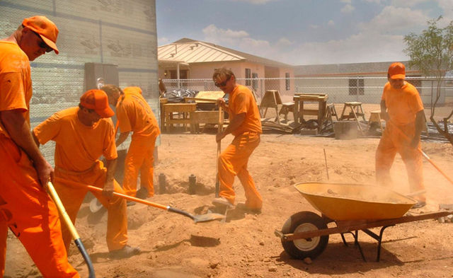
Law Enforcement
The prisoner at work program would be open to all political subdivisions, including the county, townships, villages, and cities
Diversion aspects in coordination with the courts are possible
Work accomplished by PAW is valued at approximately $120,000 annually
Work would free township and Engineer personnel (example)
Would require an additional deputy and van - $80,000
Return on Investment: $40,000 or 50%, the first year; as much as 100% the second year

Slide 20
Law Enforcement
No additional meetings are scheduled at this time
Proposal for Prisoners at Work does not meet requirements of the LGIF program, but was analyzed in terms of the concepts of Return on Investment and for how it would provide benefit to multiple political subdivisions, savings costs

Slide 21
Work Groups
Financial Processes
(Combined with MUNIS Advisory Group)
Meeting March 29 and regularly after that
Working on ways to increase electronic disbursements and receipts and to automate additional financial processes to be more efficient
Centralized Procurement
The group’s purpose is to identify potential opportunities for increasing savings through volume purchasing (will meet later in 2012)

Slide 22
“Parking Lot”
Some topics were not addressed by the groups because they did not fall into the group’s themes or were not practical to address today
These topics should be considered for additional review in the future; the full group did not want to loose ideas brought forth

Slide 23
Recommendations
Submit IT proposal during the first part of 2012
Pleased with progress thus far
Gather data and partner information for the Road/Bridge loan proposal for later in the year

Slide 24
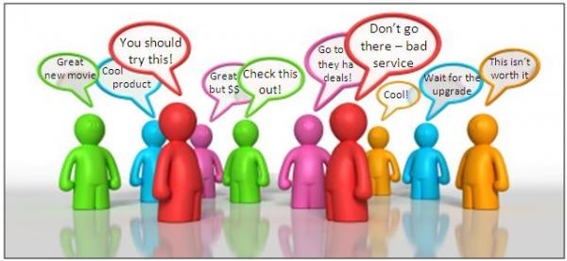
Recommendations
Continue to analyze potential of sharing employees and using volunteers (group will connect with departments as needed)
Reconvene Law Enforcement Group if joint dispatching and shared property rooms can be approached as a feasibility study
Continue to conduct research for Public Defender responsibilities in order for the subgroup to form a recommendation

Slide 25
Full Group
The full group met from October 2011– first of February 2012
The full group can be reconvened
If there are additional topics to review or examine
If the subgroups need feedback or input
Upon request of the Board of Commissioners
In March, Carri drafted a summary for the full group

Slide 26
Subgroups
Subgroups are meeting their charges
Chairs will call meetings as needed
Deadlines are self-imposed (unless a grant or loan application is available)
In other words, the work
is ongoing – part of the
culture

Slide 27
Work groups
Financial processes will be reviewed along with the MUNIS Advisory Group (meets every other month)
Centralized procurement may need help in conducting analysis and moving forward

Slide 28
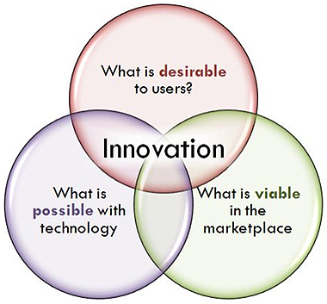
Innovation
The work accomplished thus far is very good
Participants have commented on the long overdue discussions
Additional knowledge has been gained
Departmental processes
Costs of administrative tasks
Opportunities to connect with others outside of Fairfield County’s subdivision
Concepts of ROI
Knowledge about practices in other areas

Slide 29
More work needs to be done…
We have an opportunity to champion consolidation, collaboration, and mergers
More collaboration innovation = LGIF opportunities and other opportunities
Co production
Efficiency
Shared Services
Mergers

Slide 30
IDEAS?
Please be in touch with Carri
If you engage in a performance audit, share results
If you know of other performance audits that are similar to our area, share those results

Slide 31
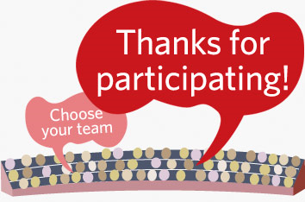
Thanks…
Thanks to those who have participated
Thanks to those who are continuing the work
Thanks to those share new ideas about mergers, consolidations or collaborations

Slide 32
Resources
www.skinnyohio.org
http://www.auditor.state.oh.us/sharedservices/default.htm
http://www.development.ohio.gov/urban/LGIF.htm

Slide 33
Questions?
Carri Brown
brownc12@odjfs.state.oh.us

